Slide 1
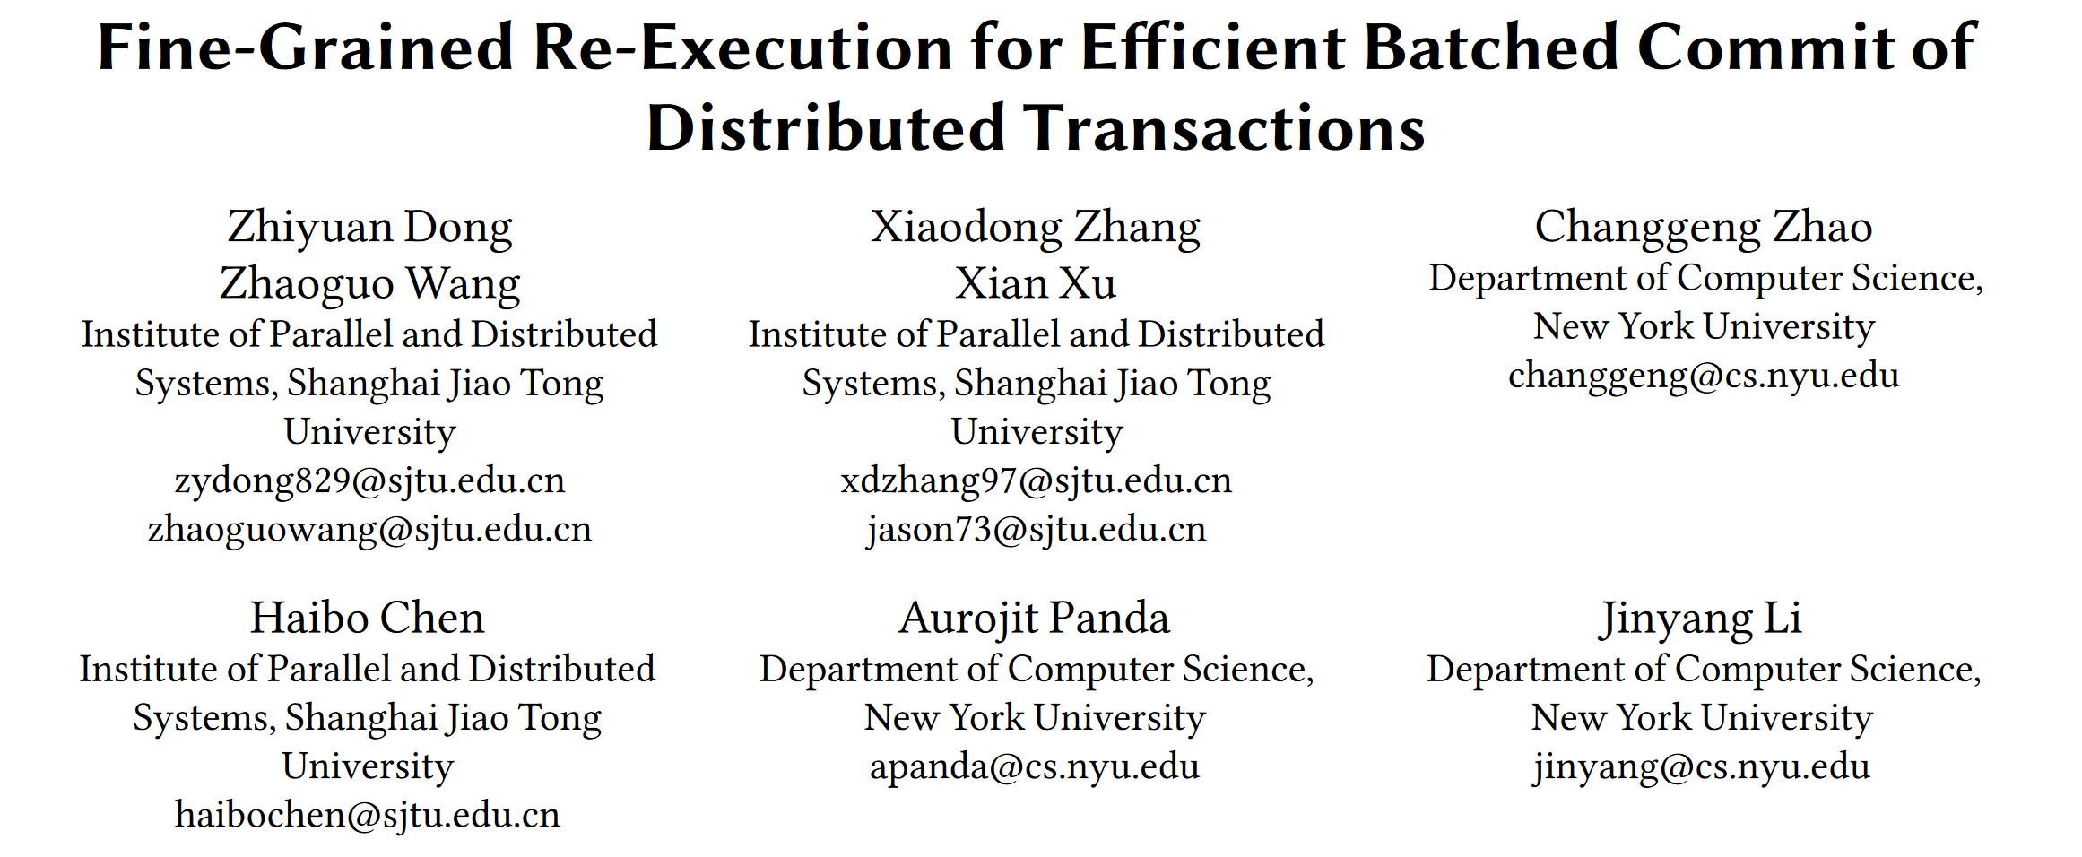
VLDB 2023

Slide 2
Outline
Introduction
Key idea
Contribution
System design & Implementation
Evaluation
Conclussion

Slide 3
Introduction
Reasons why distributed transactions tend to be slow.
Data is partitioned across multiple nodes, the system often must fetch data remotely during transaction execution.
Need to coordinate across multiple nodes to ensure serializability.
Executing and committing a transaction requires multiple round trips of blocking communication.
Former study of reducing the amount of communication.
Caching.
Reducing remote read operations on storage nodes.
Batching.
Amortize the communication needed across multiple transactions.

Slide 4
Challenges of Caching and Batching
When meets with single-write-multiple-read system (e.g. single-master Aurora), it achieves impressive performance using caching and batching.
However, under contention, cached reads can miss writes recently committed by other nodes, causing the corresponding transactions to abort.
When transactions are batched together for validation, the invalidation of a transaction will cause other transactions in the batch to abort.

Slide 5
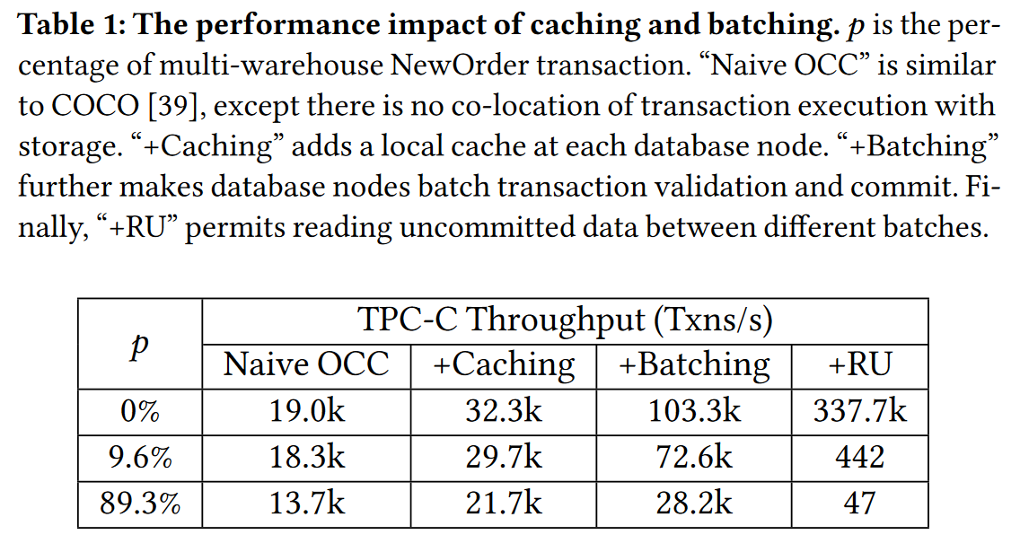
Challenges of Caching and Batching
In low contention, caching and batching can increase throughput by almost several times, and when reading uncommitted data, throughput is enormous;
In high contention, batched validation increases the likelihood of conflicts between batches,a single aborted transaction causes the entire batch of transactions to abort.

Slide 6
Outline
Introduction
Key idea
Contribution
System design & Implementation
Evaluation
Conclussion

Slide 7
Key idea
Our key idea is to “repair” nonserializable transactions by applying a minimal fix rather than aborting an entire transaction batch. Transactions are fixed by re-executing operations affected by stale and invalidated reads.
Transactions are expressed as a dataflow graph of operations to make their dependencies explicit.
Proposed a tiered commit protocol.
Local Commit: 2PL and other local transactions can read uncommitted data.
Global Commit: 2PC and Fine-grained Re-execution transactions which validate failed.

Slide 8
Outline
Introduction
Key idea
Contribution
System design & Implementation
Evaluation
Conclussion

Slide 9
Contribution
Hackwrench exploits caching and batching to reduce communication during transaction execution and commit.
propose a tiered commit protocol to validate and commit transactions in two stages, ensuring serializability first within the local node that has executed the transactions and then across all nodes globally.
To mitigate increased conflicts due to stale cache and batched commit, we propose fine-grained re-execution to “fix” stale or invalidated reads instead of doing traditional wholesale abort-and-retry.
For one-shot transactions, we propose the fast-path optimization.

Slide 10
Outline
Introduction
Key idea
Contribution
System design & Implementation
Evaluation
Conclussion

Slide 11
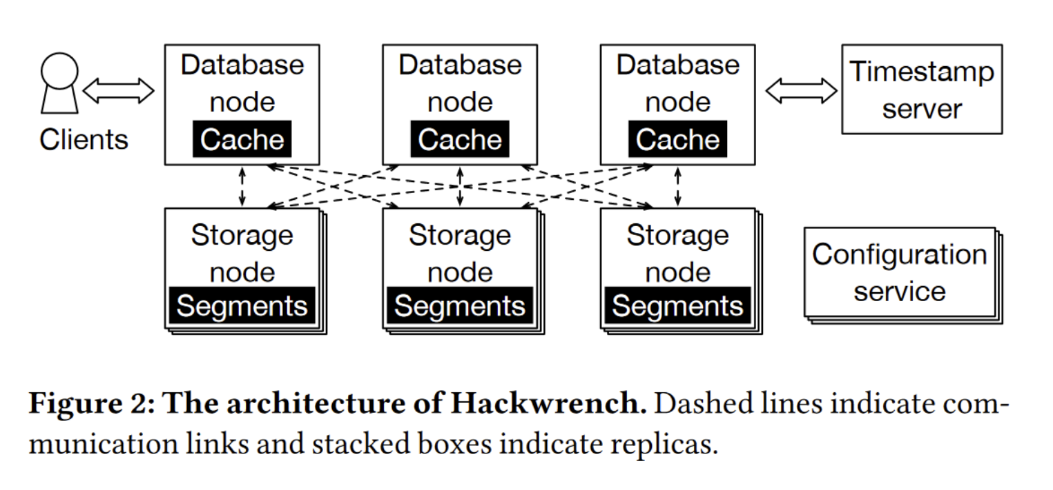
System design
Database node 执行事务和协调事务提交的计算节点
Storage node 保存数据并验证分布式事务的存储节点
Timestamp server 用于给每个事务分配一个全局的提交时间戳

Slide 12
Transaction Execution and Local Commit
Transaction Execution
In Hackwrench, transactions are represented as stored procedures.
Hackwrench provides a dataflow-based programming abstraction. With our API, each transaction is represented by a static dataflow graph. We store one copy of the static dataflow graph for a given transaction type at each node.
Local Commit
It uses two-phase locking to ensure strict serializability.
Upon finishing, the database node commits a transaction locally.

Slide 13
Batch Splitting
How to better segment batches at local nodes.
after a batch is formed, the database node constructs an undirected graph with transactions as nodes and edges connecting transactions accessing the same data segment.
A connected component in this graph represents a set of conflicting transactions which we merge into a sub-batch.
Different sub-batches in a batch access different data segments, and thus can be validated, repaired, and committed independently.

Slide 14
Global Commit
Different from traditional 2PC, Hackwrench’s global commit introduces two variations.
Upon validation failure, the database node re-executes affected operations using the updated cache and dataflow graph instead of all transactions abort.
Hackwrench relies on a timestamp server to determine the commit order of batches. Transactions can be repaired sequentially through the order of timestamps;

Slide 15
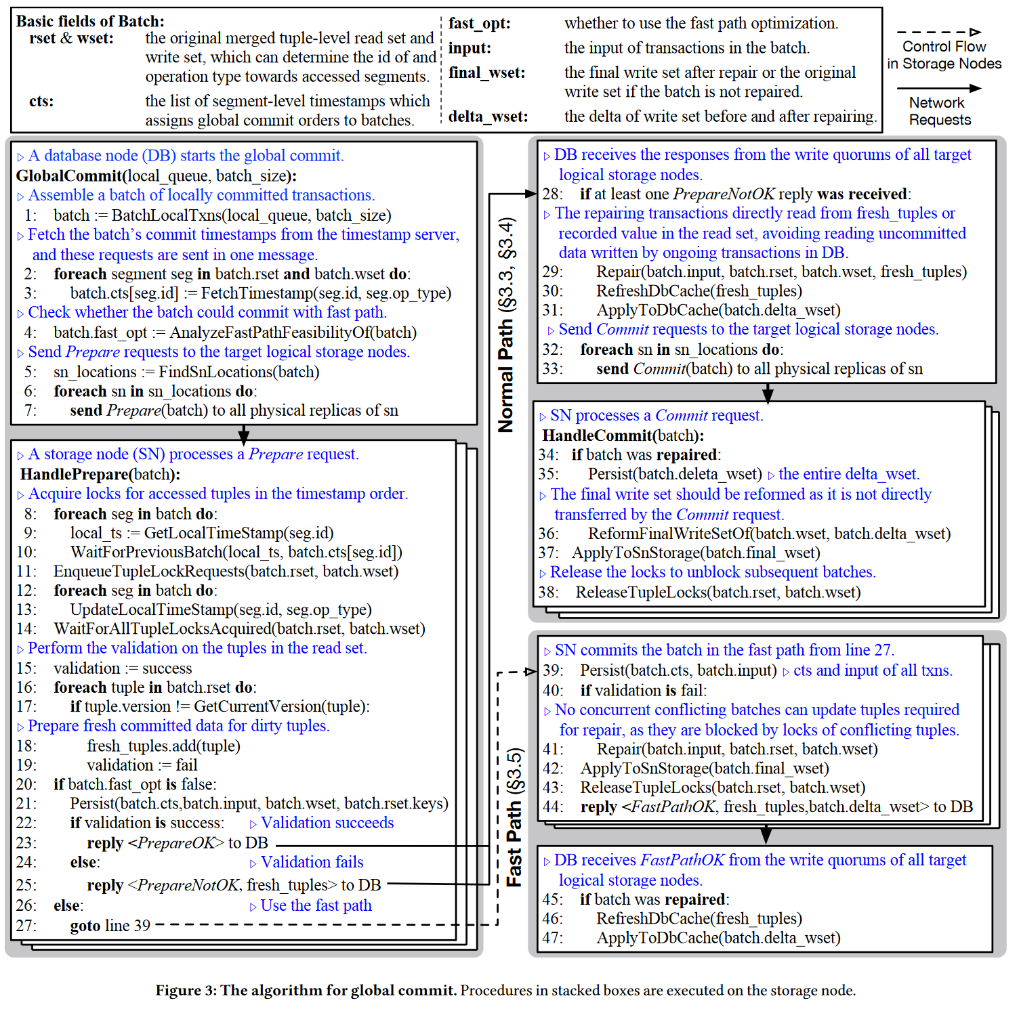
Global Commit

Slide 16
Transaction Repair
To mitigate the abort cost, we need a more efficient solution than aborting and retrying a batch of transactions. Our insight is that it is cheaper to repair the transactions batch by selectively re-executing operations affected by stale or invalid reads.
An intuitive approach for re-execution is constructing a large dependency graph for all transactions in one batch and repairing accordingly.
Runtime overhead for dependency graph construction and traversal.
Hackwrench uses a simple but efficient way instead. As transactions within the same batch are totally ordered, Hackwrench repairs transactions sequentially in the total order.
To repair one transaction, Hackwrench re-executes it according to its static dataflow graph.

Slide 17
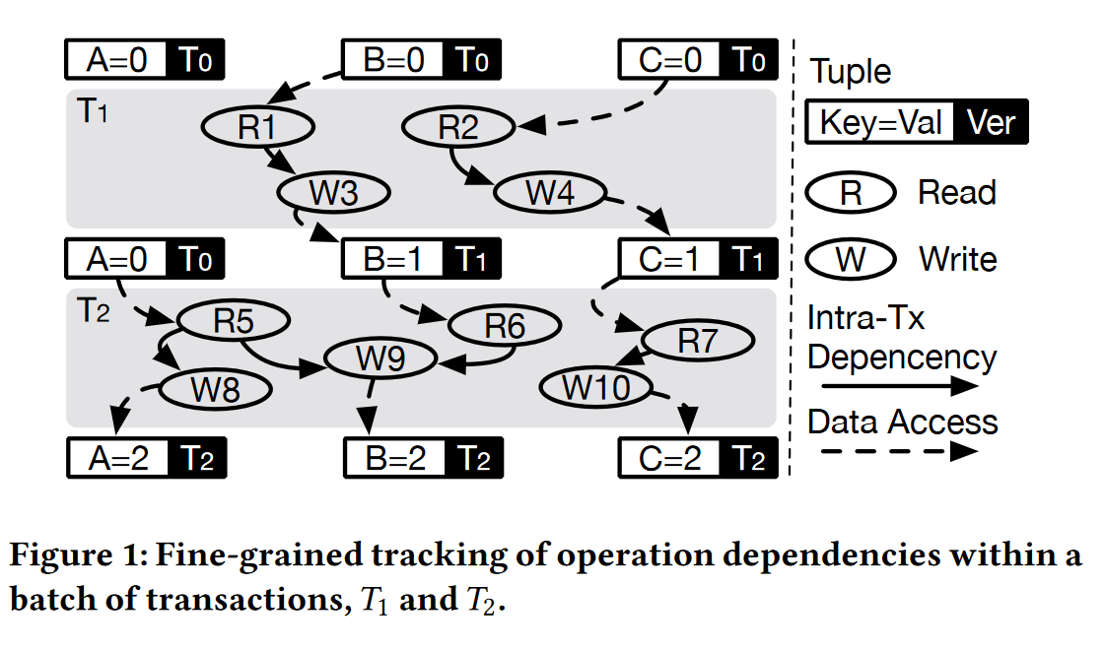
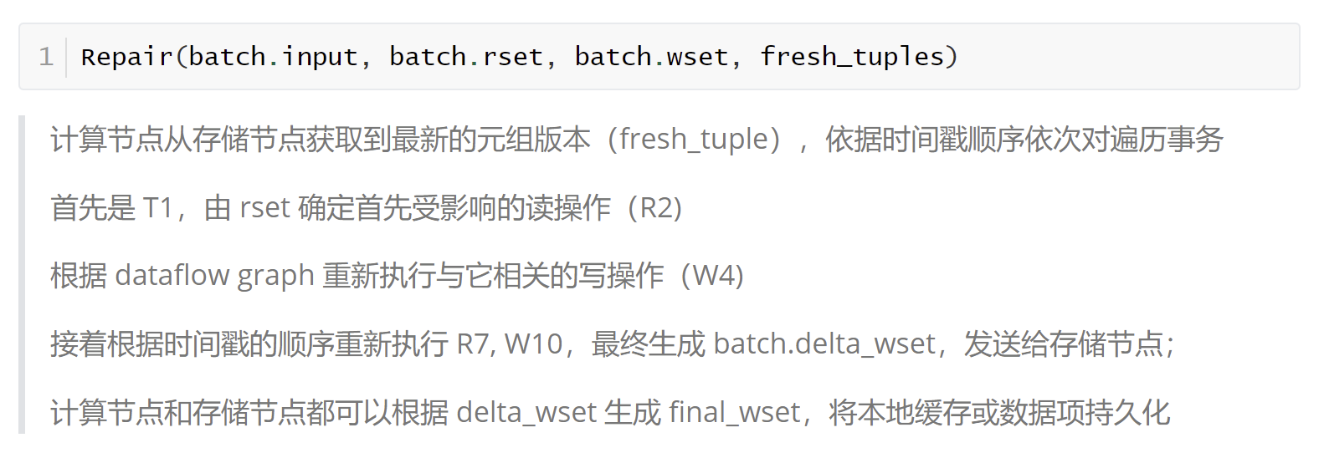
Fine-Grained Repair by Dataflow Graph

Slide 18
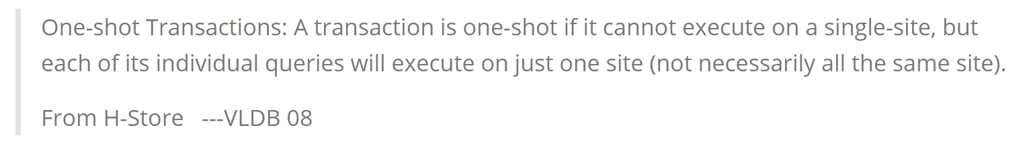
Fast-path Optimization
One-shot Transaction.
Fast-path Optimization.
Statements within one-shot transactions can be executed on the respective storage nodes where the data segments reside.
If they are still global commit through tiered commit protocol, it will result in unnecessary performance loss.
Hackwrench utilizes the fast-path optimization method to have repair and commit tasks directly handled by the storage nodes, without relying on compute nodes.

Slide 19
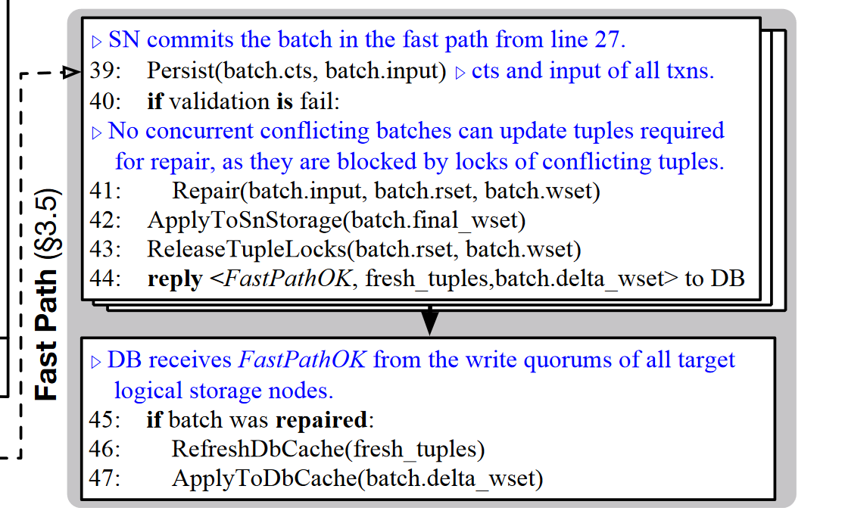
Fast-path Optimization

Slide 20
Outline
Introduction
Key idea
Contribution
System design & Implementation
Evaluation
Conclussion

Slide 21
Benchmarks and workloads.
TPC-C.
In the benchmark standard, when a NewOrder transaction updates the Stock tuple, there is a 1% probability that the tuple belongs to a remote warehouse.
The higher the remote access probability(r), the more remote distributed NewOrder transactions are.
Thus, we vary 𝑟to see how Hackwrench performs.
FDB-Micro.
Key-value benchmark.
The workload is a mix of 80% read-only transactions with 20% read-write transactions.
he parameter 𝑑dictates the percentage of distribution transactions, the rest are local transactions.

Slide 22
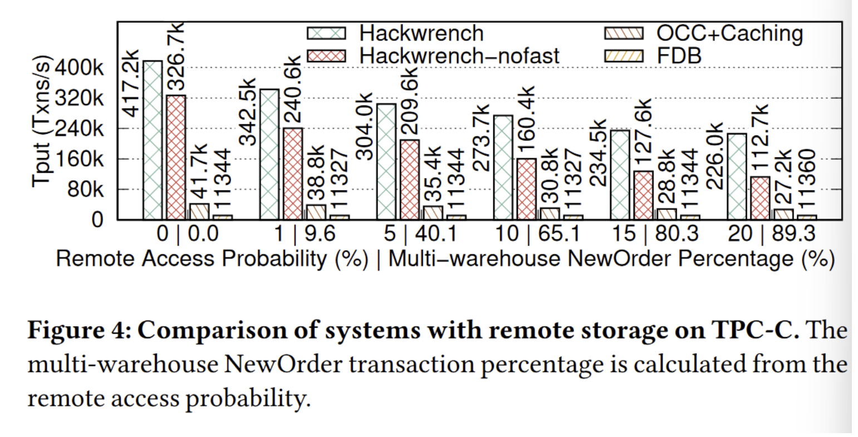
Experiment 1
Comparing the Throughput under different proportions of distributed transactions.

Slide 23
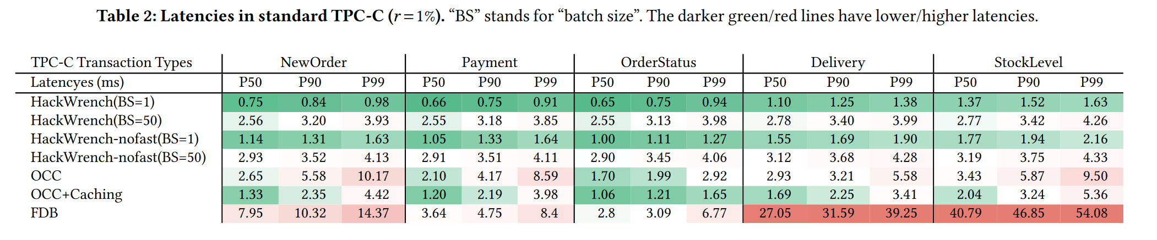
Experiment 2
Comparing the latency under different batches and systems.

Slide 24
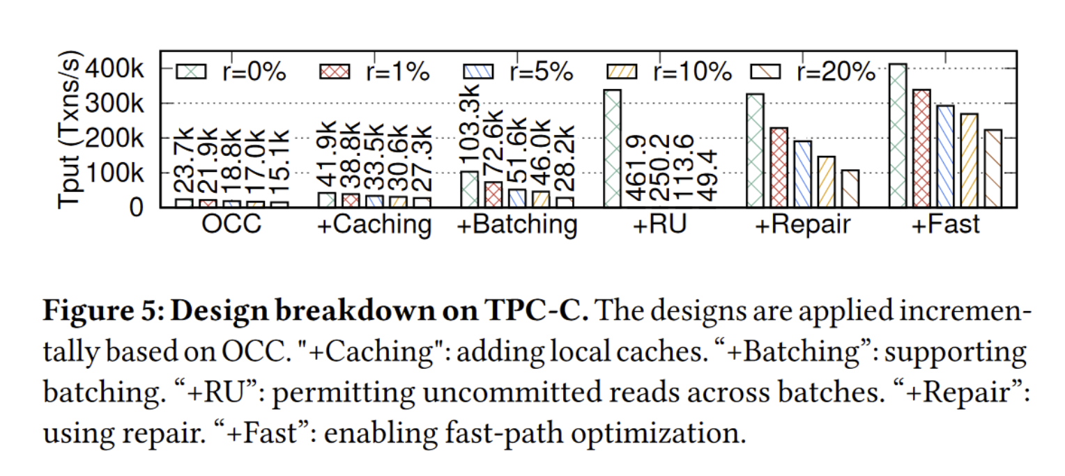
Experiment 3
Comparing the five optimization techniques to determine which ones yield the most significant improvements based on the foundation of OCC.

Slide 25
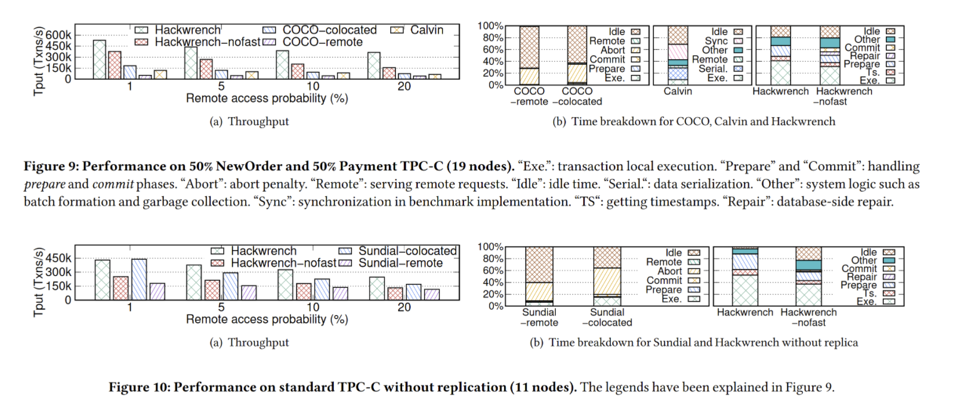
Experiment 4
Comparing the CPU utilization of each system.

Slide 26
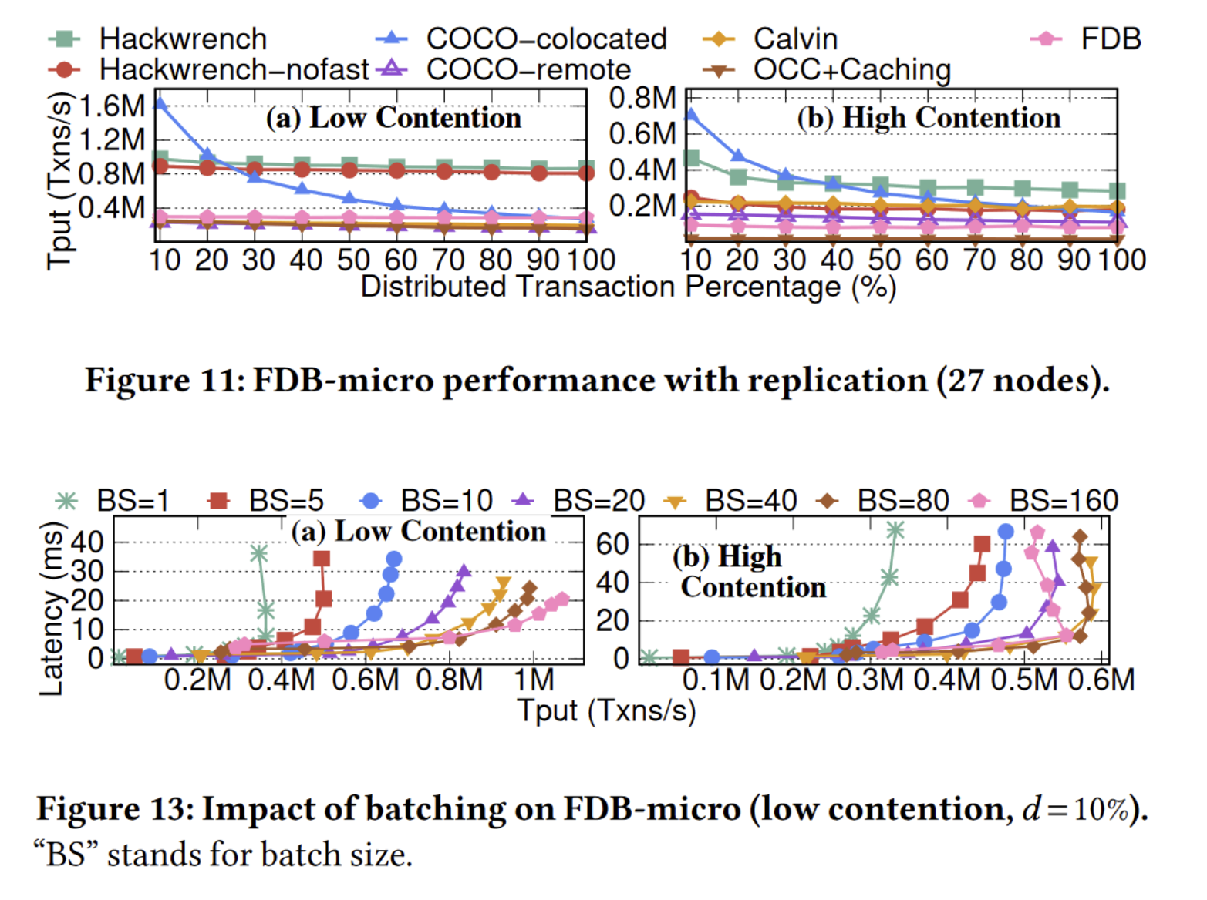
Experiment 5

Slide 27
Outline
Introduction
Key idea
Contribution
System design & Implementation
Evaluation
Conclussion

Slide 28
Conclusion
A design for distributed databases using best-effort caching and batched commit for transactions execution at multiple database nodes with remote storage.
Hackwrench uses fine-grained repair to mitigate the harmful effect of increased transaction conflicts due to stale cache reads and batched validation.
For one-shot transactions, we propose the fast-path optimization which performs re-execution at storage instead of database nodes with one fewer round-trip and no 2PC coordination.
TPC-C results show that Hackwrench achieves much higher throughput than an OCC system, FoundationDB, Calvin, COCO, and Sundial.

